Slide 1
Expected Value, the Law of Averages, and the Central Limit Theorem
Math 1680

Slide 2
Overview
Chance Processes and Box Models
Expected Value
Standard Error
The Law of Averages
The Central Limit Theorem
Roulette
Craps
Summary

Slide 3
Chance Processes and Box Models
Recall that we can use a box model to describe chance processes
  Flipping a coin
  Rolling a die
  Playing a game of roulette
The box model representing the roll of a single die is
1 2 3 4 5 6

Slide 4
Chance Processes and Box Models
If we are interested in counting the number of even values instead, we label the tickets differently
  We get a “1” if a 2, 4, or 6 is thrown
  We get a “0” otherwise
  To find the probability of drawing a ticket type from the box
    Count the number of tickets of that type
    Divide by the total number of tickets in the box
We can say that the sum of n values drawn from the box is the total number of evens thrown in n rolls of the dice
0 ³ 1 ³

Slide 5
Expected Value
Consider rolling a fair die, modeled by drawing from
  The smallest possible value is 1
  The largest possible value is 6
1 2 3 4 5 6

Slide 6
Expected Value
The expected value (EV) on a single draw can be thought of as a weighted average
  Multiply each possible value by the probability that value occurs
  Add these products together
    EV₁ = (1/6)(1)+(1/6)(2)+(1/6)(3)+(1/6)(4)+(1/6)(5)+(1/6)(6)
    = 3.5
    Expected values may not be feasible outcomes
  The expected value for a single draw is also the average of the values in the box

Slide 7
Expected Value
If we play n times, then the expected value for the sum of the outcomes is the expected value for a single outcome multiplied by n
  EV_{n} = n(EV₁)
For 10 rolls of the die, the expected sum is 10(3.5) = 35

Slide 8
Expected Value
Flip a fair coin and count the number of heads
  What box models this game?
  How many heads do you expect to get in…
    10 flips?
    100 flips?
0 1
5
50

Slide 9
Expected Value
Pay $1 to roll a fair die
  You win $5 if you roll an ace (1)
  You lose the $1 otherwise
What box models this game?
How much money do you expect to make in…
  1 game?
  5 games?
This is an example of a fair game
-$1 ⁵ $5 ¹
$0
$0

Slide 10
Standard Error
Bear in mind that expected value is only a prediction
  Analogous to regression predictions
EV is paired with standard error (SE) to give a sense of how far off we may still be from the expected value
  Analogous to the RMS error for regression predictions

Slide 11
Standard Error
Consider rolling a fair die, modeled by drawing from
The smallest possible value is 1
  The largest possible value is 6
  The expected value (EV) on a single draw is 3.5
The SE for the single play is the standard deviation of the values in the box
1 2 3 4 5 6

Slide 12
Standard Error
If we play n times, then the standard error for the sum of the outcomes is the standard error for a single outcome multiplied by the square root of n
  SE_{n} = (SE₁)sqrt(n)
For 10 rolls of the die, the standard error is (1.71)sqrt(10)  5.41

Slide 13
Standard Error
In games with only two outcomes (win or lose) there is a shorter way to calculate the SD of the values
  SD = (|win – lose|)[P(win)P(lose)]
    P(win) is the number of winning tickets divided by the total number of tickets
    P(lose) = 1 - P(win)
What is the SD of the box ?
-$1 ⁴ $4 ¹
$2

Slide 14
Standard Error
The standard error gives a sense of how large the typical chance error (distance from the expected value) should be
  In games of chance, the SE indicates how “tight” a game is
    In games with a low SE, you are likely to make near the expected value
    In games with a high SE, there is a chance of making significantly more (or less) than the expected value

Slide 15
Standard Error
Flip a fair coin and count the number of heads
  What box models this game?
  How far off the expected number of heads should you expect to be in…
    10 flips?
    100 flips?
0 1
1.58
5

Slide 16
Standard Error
Pay $1 to roll a fair die
  You win $5 if you roll an ace (1)
  You lose the $1 otherwise
What box models this game?
How far off your expected gain should you expect to be in…
  1 game?
  5 games?
-$1 ⁵ $5 ¹
$2.24
$5.01

Slide 17
The Law of Averages
When playing a game repeatedly, as n increases, so do EV_{n} and SE_{n}
  However, SE_{n} increases at a slower rate than EV_{n}
Consider the proportional expected value and standard error by dividing EV_{n} and SE_{n} by n
  The proportional EV = EV₁ regardless of n
  The proportional SE decreases towards 0 as n increases

Slide 18
The Law of Averages
Flip a fair coin over and over and over and count the heads
n | EV_{n} | SE_{n} | SE_{n}/n
10 | 5 | 1.58 | 15.8%
100 | 50 | 5 | 5%
1000 | 500 | 15.8 | 1.6%
10000 | 5000 | 50 | 0.5%

Slide 19
The Law of Averages
The tendency of the proportional SE towards 0 is an expression of the Law of Averages
  In the long run, what should happen does happen
  Proportionally speaking, as the number of plays increases it becomes less likely to be far from the expected value

Slide 20
The Central Limit Theorem
If you flip a fair coin once, the distribution for the number of heads is
  1 with probability 1/2
  0 with probability 1/2
This can be visualized with a probability histogram

Slide 21
The Central Limit Theorem
As n increases, what happens to the histogram?
  This illustrates the Central Limit Theorem

Slide 22
The Central Limit Theorem
The Central Limit Theorem (CLT) states that if…
  We play a game repeatedly
  The individual plays are independent
  The probability of winning is the same for each play
Then if we play enough, the distribution for the total number of times we win is approximately normal
  Curve is centered on EV_{n}
  Spread measure is SE_{n}
Also holds if we are counting money won

Slide 23
The Central Limit Theorem
The initial game can be as unbalanced as we like
  Flip a weighted coin
    Probability of getting heads is 1/10
  Win $8 if you flip heads
  Lose $1 otherwise

Slide 24
The Central Limit Theorem
After enough plays, the gain is approximately normally distributed

Slide 25
The Central Limit Theorem
The previous game was subfair
  Had a negative expected value
  Play a subfair game for too long and you are very likely to lose money
A casino doesn’t care whether one person plays a subfair game 1,000 times or 1,000 people play the game once
  The casino still has a very high probability of making money

Slide 26
The Central Limit Theorem
Flip a weighted coin
  Probability of getting heads is 1/10
  Win $8 if you flip heads
  Lose $1 otherwise
What is the probability that you come out ahead in 25 plays?
What is the probability that you come out ahead in 100 plays?
 42.65%
 35.56%

Slide 27
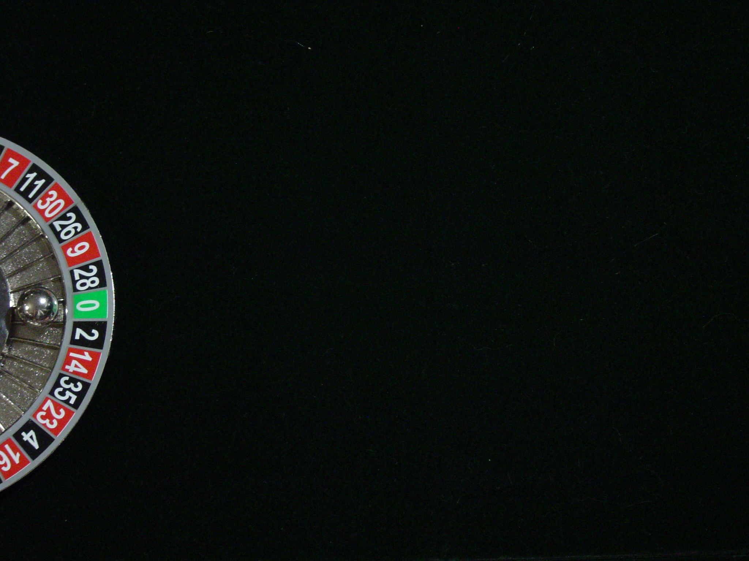
Roulette
In roulette, the croupier spins a wheel with 38 colored and numbered slots and drops a ball onto the wheel
  Players make bets on where the ball will land, in terms of color or number
  Each slot is the same width, so the ball is equally likely to land in any given slot with probability 1/38  2.63%

Slide 28
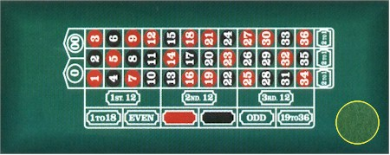
Roulette
Players place their bets on the corresponding position on the table
Single Number
35 to 1
Split
17 to 1
Four Numbers
8 to 1
Row
11 to 1
2 Rows
5 to 1
$
$
$
$
$
$
$
$
$
$
1-18/19-36
1 to 1
Even/Odd
1 to 1
Red/Black
1 to 1
Section
2 to 1
Column
2 to 1

Slide 29
Roulette
One common bet is to place $1 on red
  Pays 1 to 1
    If the ball falls in a red slot, you win $1
    Otherwise, you lose your $1 bet
  There are 38 slots on the wheel
    18 are red
    18 are black
    2 are green
What are the expected value and standard error for a single bet on red?
 -$0.05 ± $1.00

Slide 30
Roulette
One way of describing expected value is in terms of the house edge
  In a 1 to 1 game, the house edge is P(win) – P(lose)
    For roulette, the house edge is 5.26%
Smart gamblers prefer games with a low house edge

Slide 31
Roulette
Playing more is likely to cause you to lose even more money
  This illustrates the Law of Averages
n | EV_{n} | SE_{n}
1 | -$.05 | $1.00
10 | -$.53 | $3.16
100 | -$5.26 | $9.99
1000 | -$52.63 | $31.58
10000 | -$526.32 | $99.86

Slide 32
Roulette
Another betting option is to bet $1 on a single number
  Pays 35 to 1
    If the ball falls in the slot with your number, you win $35
    Otherwise, you lose your $1 bet
  There are 38 slots on the wheel
What are the expected value and standard error for one single number bet?
 -$0.05 ± $5.76

Slide 33
Roulette
The single number bet is more volatile than the red bet
  It takes more plays for the Law of Averages to securely manifest a profit for the house
n | EV_{n} | SE_{n}
1 | -$.05 | $1.00
10 | -$.53 | $18.22
100 | -$5.26 | $57.63
1000 | -$52.63 | $182.23
10000 | -$526.32 | $576.26

Slide 34
Roulette
If you bet $1 on red for 25 straight times, what is the probability that you come out (at least) even?
If you bet $1 on single #17 for 25 straight times, what is the probability that you come out (at least) even?
 40%
 48%

Slide 35
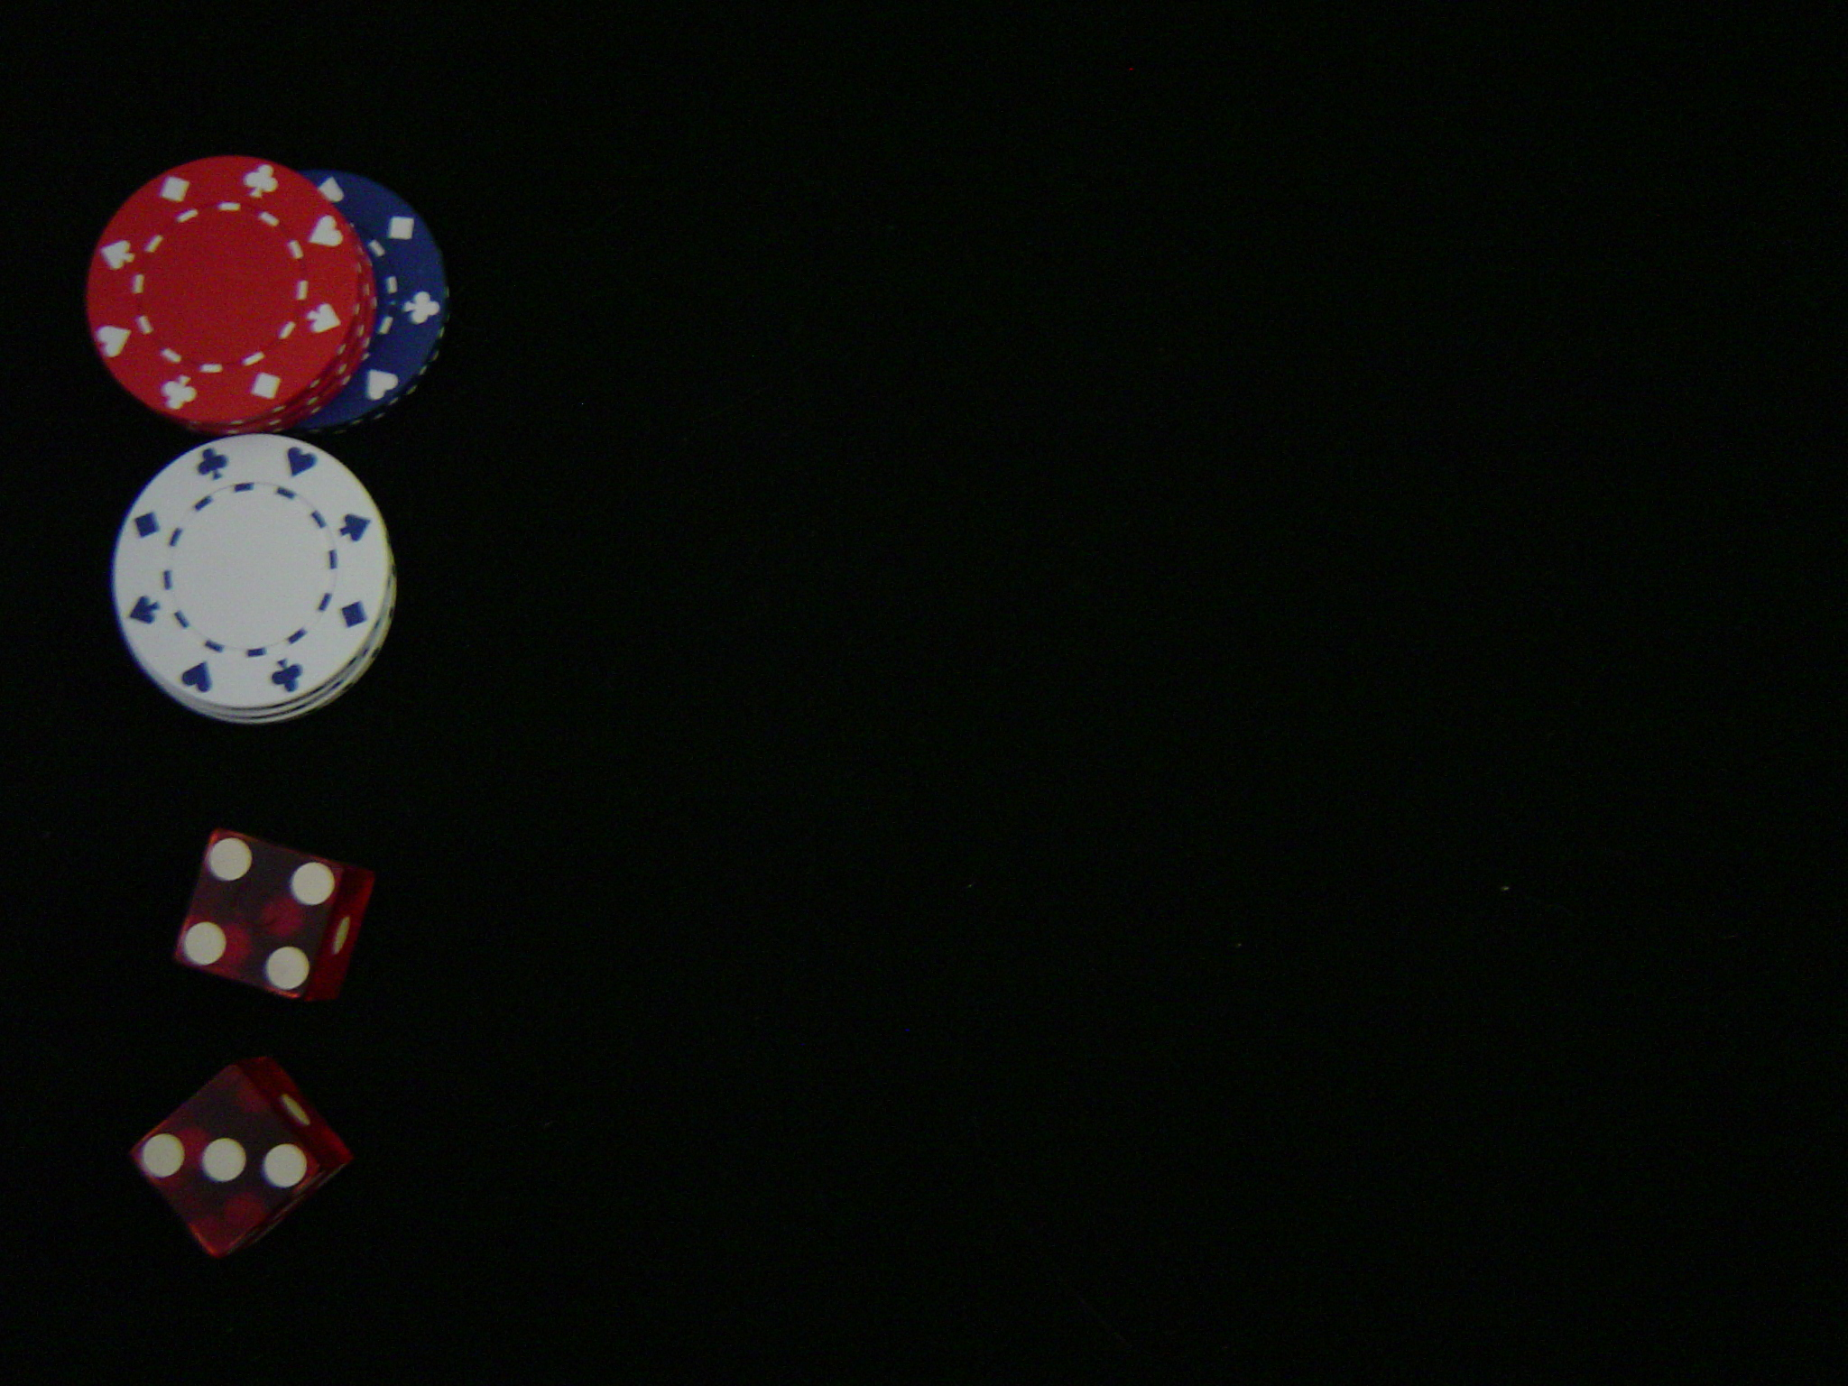
Craps
In craps, the action revolves around the repeated rolling of two dice by the shooter
  Two stages to each round
    Come-out Roll
      Shooter wins on 7 or 11
      Shooter loses on 2, 3, or 12 (craps)
    Rest of round
      If a 4, 5, 6, 8, 9, or 10 is rolled, that number is the point
      Shooter keeps rolling until the point is re-rolled (shooter wins) or he/she rolls a 7 (shooter loses)

Slide 36
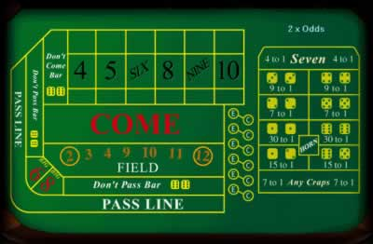
Craps
Players place their bets on the corresponding position on the table
  Common bets include
Don’t Come
1 to 1
Don’t Pass
1 to 1
Come
1 to 1
Pass
1 to 1

Slide 37
Craps
Pass/Come, Don’t Pass/Don’t Come are some of the best bets in a casino in terms of house edge
In the pass bet, the player places a bet on the pass line before the come out roll
  If the shooter wins, so does the player

Slide 38
Craps: Pass Bet
The probability of winning on a pass bet is equal to the probability that the shooter wins
  Shooter wins if
    Come out roll is a 7 or 11
    Shooter makes the point before a 7
  What is the probability of rolling a 7 or 11 on the come out roll?
8/36 ≈ 22.22%

Slide 39
Craps: Pass Bet
The probability of making the point before a 7 depends on the point
  If the point is 4, then the probability of making a 4 before a seven is equal to the probability of rolling a 4 divided by the probability of rolling a 4 or a 7
    This is because the other numbers don’t matter once the point is made
3/9 ≈ 33.33%

Slide 40
Craps: Pass Bet
What is the probability of making the point when the point is…
  5?
  6?
  8?
  9?
  10?
Note the symmetry
4/10 = 40%
5/11 ≈ 45.45%
5/11 ≈ 45.45%
4/10 = 40%
3/9 ≈ 33.33%

Slide 41
Craps: Pass Bet
The probability of making a given point is conditional on establishing that point on the come out roll
  Multiply the probability of making a point by the probability of initially establishing it
    This gives the probability of winning on a pass bet from a specific point

Slide 42
Craps: Pass Bet
Then the probability of winning on a pass bet is…
So the probability of losing on a pass bet is…
This means the house edge is
8/36 + [(3/36)(3/9) + (4/36)(4/10) + (5/36)(5/11)](2) ≈ 49.29%
100% - 49.29% = 50.71%
49.29% - 50.71% = -1.42%

Slide 43
Craps: Don’t Pass Bet
The don’t pass bet is similar to the pass bet
  The player bets that the shooter will lose
  The bet pays 1 to 1 except when a 12 is rolled on the come out roll
    If 12 is rolled, the player and house tie (bar)

Slide 44
Craps: Don’t Pass Bet
The probability of winning on a don’t pass bet is equal to the probability that the shooter loses, minus half the probability of rolling a 12
  Why half?
Then the house edge for a don’t pass bet is
50.71% - (2.78%)/2 = 49.32%
50.68% - 49.32% = 1.36%

Slide 45
Craps: Don’t Pass Bet
Note that a don’t pass bet is slightly better than a pass bet
  House edge for pass bet is 1.42%
  House edge for don’t pass bet is 1.36%
However, most players will bet on pass in support of the shooter

Slide 46
Craps: Come Bets
The come bet works exactly like the pass bet, except a player may place a come bet before any roll
  The subsequent roll is treated as the “come out” roll for that bet
The don’t come bet is similar to the don’t pass bet, using the subsequent roll as the “come out” roll

Slide 47
Craps: Odds
After a point is established, players may place additional bets called odds on their original bets
  Odds reduce the house edge even closer to 0
  Most casinos offer odds, but at a limit
    2x odds, 3x odds, etc…
  If the odds are for pass/come, we say the player takes odds
  If the odds are for don’t pass/don’t come, we say the player lays odds

Slide 48
Craps: Odds
Odds are supplements to the original bet
  The payoff for an odds bet depends on the established point
  For each point, the payoff is set so that the house edge on the odds bet is 0%

Slide 49
Craps: Odds
If the point is a 4 (or 10), then the probability that the shooter wins is 3/9 ≈ 33.33%
  The payoff for taking odds on 4 (or 10) is then 2 to 1
If the point is a 5 (or 9), then the probability that the shooter wins is 4/10 = 40%
  The payoff for taking odds on 5 (or 9) is then 3 to 2
If the point is a 6 (or 8), then the probability that the shooter wins is 5/11 ≈ 45.45%
  The payoff for taking odds on 6 (or 8) is then 6 to 5

Slide 50
Craps: Odds
Similarly, the payoffs for laying odds are reversed, since a player laying odds is betting on a 7 coming first
  The payoff for laying odds on 4 (or 10) is then 1 to 2
  The payoff for laying odds on 5 (or 9) is then 2 to 3
  The payoff for laying odds on 6 (or 8) is then 5 to 6

Slide 51
Craps: Odds
Keep in mind that although odds bets are fair-value bets, you must make a negative expectation bet in order to play them
  The house still has an edge due to the initial bet, but the odds bet dilutes the edge

Slide 52
Craps: Odds
Suppose you place $2 on pass at a table with 2x odds
  Come out roll establishes a point of 5
  You take $4 odds on your pass
Shooter eventually rolls a 5
  You win $2 for your original bet and $6 for the odds bet

Slide 53
Craps
Suppose a player bets $1 on pass for 25 straight rounds
  What is the probability that she comes out (at least) even?
 47%

Slide 54
Summary
Many chance processes can be modeled by drawing from a box filled with marked tickets
  The value on the ticket represents the value of the outcome
The expected value of an outcome is the weighted average of the tickets in the box
  Gives a prediction for the outcome of the game
  A game where EV = 0 is said to be fair

Slide 55
Summary
The standard error gives a sense of how far off the expected value we might expect to be
  The smaller the SE, the more likely we will be close to the EV
Both the EV and SE depend on the number of times we play

Slide 56
Summary
As the number of plays increases, the probability of being proportionally close to the expected value also increases
  This is the Law of Averages
If we play enough times, the random variable representing our net winnings is approximately normal
  True regardless of the initial probability of winning

Slide 57
Summary
Roulette and craps are two popular chance games in casinos
  Both games have a negative expected value, or house edge
  Intelligent bets are those with small house edges or high SE’s

